Slide 1
COMP 2310 Data Structures and Algorithms
Lecture 11
Introduction to Sort and Search Algorithms

Slide 2
The Sorting Problem
Sorting: Arranging a list of elements in ascending or descending order
Input: A sequence of n values : a1, a2, . . . ,an
Output: A permutation (reordering) a1’, a2’, . . . , an’ of the input sequence such that
a1’ ≤ a2’ ≤ · · · ≤ an’ Example : Input : 2, 3, 1, 15, 11, 23, 1
Output : 1, 1, 2, 3, 11, 15, 23

Slide 3
Sort Algorithms
There are many well known sort algorithms:
Selection Sort
Bubble Sort
Insertion Sort
Merge Sort
Quicksort
Counting Sort
Bucket Sort
………………
Sort algorithms differ in complexity:
Some are not efficient: Quadratic complexity → Inefficient
Some are efficient: Sub-quadratic complexity → Efficient
We are going to consider examples from each category.

Slide 4
Sorting Data Records
Usually we will sort a number of records containing a number of fields based on a key. Example records:
19991532 | Stevenson | Monica | 3 Glendridge Ave.
19990253 | Redpath | Ruth | 53 Belton Blvd.
19985832 | Kilji | Islam | 37 Masterson Ave.
20003541 | Groskurth | Ken | 12 Marsdale Ave.
19981932 | Carol | Ann | 81 Oakridge Ave.
20003287 | Redpath | David | 5 Glendale Ave.
Sorting Numerically by ID Number
Sorting Lexicographically by surname, then given name
19981932 | Carol | Ann | 81 Oakridge Ave.
19985832 | Khilji | Islam | 37 Masterson Ave.
19990253 | Redpath | Ruth | 53 Belton Blvd.
19991532 | Stevenson | Monica | 3 Glendridge Ave.
20003287 | Redpath | David | 5 Glendale Ave.
20003541 | Groskurth | Ken | 12 Marsdale Ave.
19981932 | Carol | Ann | 81 Oakridge Ave.
20003541 | Groskurth | Ken | 12 Marsdale Ave.
19985832 | Kilji | Islam | 37 Masterson Ave.
20003287 | Redpath | David | 5 Glendale Ave.
19990253 | Redpath | Ruth | 53 Belton Blvd.
19991532 | Stevenson | Monica | 3 Glendridge Ave.

Slide 5
A Suboptimal Sort Algorithm: Bogosort
BogoSort also known as permutation sort, stupid sort, slow sort, shotgun sort or monkey sort is a particularly ineffective algorithm.
Bogosort simply shuffles a collection randomly until it is sorted:
1. Randomly order the objects
2. Check if they’re sorted, if not, go back to Step 1
Best case: O(n)
Worst case: O(∞) →There is no upper limit.
Example: Generate 100 random numbers, check the order. Shuffle the numbers and check the order….
Note: Bogosort is not an applicable sorting algorithm, it is used only for educational purposes.
"Bogosort is adorable, when it isn't running"

Slide 6
Selection Sort Algorithm
//Sorts the elements of A. The length of A is n.
SELECTION_SORT(A,n)
for i ← 1 to n − 1
min ← i //Index of min
for j ← i + 1 to n
if A[j ] < A[min]
min← j
swap (A[ i ] , A[min] ) //Exchange

Slide 7
Selection Sort
The method:
Assume the data values are in an array.
Find the smallest element in the array
Exchange it with the element in the first position
Find the second smallest element and exchange it with the element in the second position
Continue until the array is sorted.

Slide 8
Selection Sort: Example: A[ ]=8, 4, 6, 9, 2, 3,1
8
4
6
9
2
3
1
1
2
3
4
9
6
8
1
4
6
9
2
3
8
1
2
3
4
6
9
8
1
2
6
9
4
3
8
1
2
3
4
6
8
9
1
2
3
9
4
6
8
1
2
3
4
6
8
9

Slide 9
Selection Sort: Time Complexity
To find the minimum element from an array of N elements, N−1 comparisons are required.
After moving the minimum element into its proper position, the size of unsorted array reduces to N−1.
Then N−2 comparisons are required to find the minimum in the unsorted array, and so on…
Therefore the number of comparisons
= (N−1) + (N−2) + .............. + 1
= (N⋅(N−1))/2
=O(N²)

Slide 10
Selection Sort: Time Complexity
Maximum number of swaps = N
= O(N)
So, the overall complexity is
T(n) = O(N²) +O(N)
= O(N²)
Notice that best, worst and average case complexities are the same: O(N²)
→Selection sort has the same time complexity on every input composition.

Slide 11
Buble Sort: Algorithm
//n is array size
Notes:
11

Slide 12
Bubble Sort
The method:
In each step, compare each pair of adjacent items and swap them if they are in the wrong order.
Repeat the steps through the list until no swaps are needed.
i
8
4
6
9
2
3
1
1
2
3
n

Slide 13
C++ code for Bubble Sort Function
void bubleSort(int A[ ], int n)
{
for(int k = n-1; k >= 1; k--)
{
for(int j = 0; j<＝k-1; j++)
{
if(A[j + 1] < A[j]) //Swap
{
t = A[j + 1];
A[j + 1] = A[j];
A[j] = t;
}
}
}
}
Notes:
13

Slide 14
Bubble Sort: Example
Example: Sort the following array using the bubble sort algorithm
A : (6 1 4 3 8)
First Pass: ( 6 1 4 3 8 ) ( 1 6 4 3 8 ) compare the first two elements : 6>1 swap them ( 1 6 4 3 8 ) ( 1 4 6 3 8 ), swap since 6 > 4 ( 1 4 6 3 8 ) ( 1 4 3 6 8 ), swap since 6 > 3 ( 1 4 3 6 8 ) ( 1 4 3 6 8 ), do not swap, since (8>6)
→ 8 is now in its correct position.
Notes:
14

Slide 15
Bubble Sort: Example
Second Pass: ( 1 4 3 6 8 ) ( 1 4 3 6 8 ) ( 1 4 3 6 8 ) ( 1 3 4 6 8 ) ( 1 3 4 6 8 ) ( 1 3 4 6 8 ) ( 1 3 4 6 8 )
6 is now in its correct position.
Third Pass: ( 1 3 4 6 8 ) ( 1 3 4 6 8 ) ( 1 3 4 6 8 ) ( 1 3 4 6 8 ) ( 1 3 4 6 8 )
4 is now in its correct position.
Forth Pass: ( 1 3 4 6 8 ) ( 1 3 4 6 8 ) ( 1 3 4 6 8 ) → Sorted !
Notes:
15

Slide 16
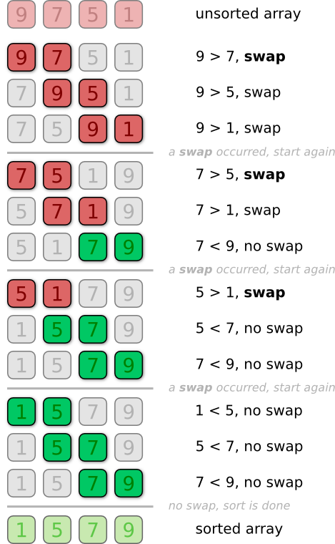
BUBBLE SORT: Example 2

Slide 17
Complexity of Bubble Sort
Number of times that the lines 1 and 2 is executed: n-1 in 1st pass, n-2 in 2nd pass, n-3 in 3rd pass…
T(n)=
Notes:
17

Slide 18
Bubble Sort: Worst and Best Cases
Worst case number of exchanges: O(n²)
How many comparisons and exchanges will be needed?
Worst case: Occurs when the array is reversely sorted at the start. (A: 5, 4, 3, 2, 1)
→O(n²)
→Best case: Works best when array is sorted or nearly sorted at the start (A: 1, 2, 3, 4, 5)
→ O(n) comparisons, no exchanges.

Slide 19
A Better Version: Flagged Bubble Sort
//Do this for every k
If no swaps occur for any k, the list is sorted! →stop when there is no more swaps
Notes:
19

Slide 20
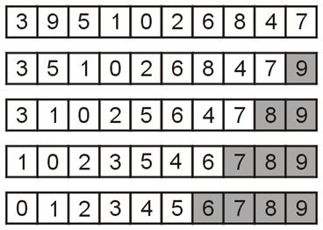
Flagged Bubble Sort: Example
Use a Boolean flag to check if no swaps occurred
If no swaps occur at any pass, the list is sorted
In this example, no swaps occurred during the 5th pass so stop.

Slide 21
INSERTION-SORT: Algorithm
INSERTION_SORT(A)
for j ← 2 to n
do key ← A[ j ]
// Insert A[ j ] into the sorted sequence A[1 . . j -1]
i ← j - 1
while i > 0 and A[i] > key
do A[i + 1] ← A[i]
i ← i – 1 //Move left
A[i + 1] ← key
Insertion sort sorts the elements in place (In place sorting)
1
2
3
4
5
6
7
8
a₁
a₂
a₃
a₄
a₅
a₆
a₇
a₈
key

Slide 22
Insertion Sort
Idea: like sorting a hand of playing cards
Start with an empty left hand and the cards facing down on the table.
Remove one card at a time from the table, and insert it into the correct position in the left hand
compare it with each of the cards already in the hand, from right to left
The cards held in the left hand are sorted

Slide 23
Insertion Sort
To insert 12, we need to make room for it by moving first 36 and then 24.
6
10
24
36
12

Slide 24
Insertion Sort
6
10
24
36
12

Slide 25
Insertion Sort
6
10
24
36
12

Slide 26
Insertion Sort
6
10
12
24
36

Slide 27
Insertion Sort: Example
input array
2 5 4 6 1 3
At each iteration, the array is divided in two sub-arrays by
moving one element from unsorted to sorted:
left sub-array
right sub-array
sorted
unsorted

Slide 28
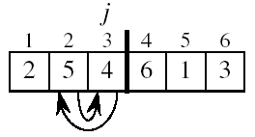
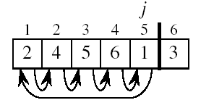
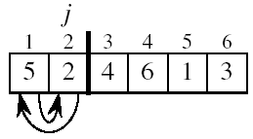
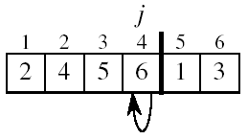
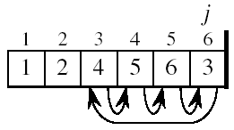
Insertion Sort: Example At each iteration, the array is divided in two sub-arrays: Sorted, unsorted

Slide 29
Analysis of Insertion Sort: Worst case
Example (8 6 4 3 1) sorted in decreasing order!
(6 8 4 3 1): 1 comparison (compare 6 and 8)
(4 6 8 3 1): 2 comparisons (compare 4 with 8 and 6)
(3 4 6 8 1): 3 comparisons (compare 3 with 8, 6 and 4)
(3 4 6 8 1): 4 comparisons (compare 1 with 8, 6, 4 and 3)
(1 3 4 6 8): Sorted.
Total number of comparisons=1+2+3+4 = 10
Notes:
29

Slide 30
Analysis of Insertion Sort: Best Case
Example (1 3 4 6 8) (Already sorted!)
(1 3 4 3 1): 1 comparison (compare 3 with 1)
(1 3 4 6 8): 1 comparison (compare 4 with 3)
(1 3 4 6 8): 1 comparison (compare 6 with 4)
(1 3 4 6 8): 1 comparisons (compare 8 with 6)
Sorted.
Total number of comparisons=1+1+1+1=4
Notes:
30

Slide 31
Insertion Sort - Analysis
Pass p involves at most p comparisons
Total comparisons T(n) = ∑ i , i = [1, n-1]
= O(n²)
Worst Case: Reversely sorted list
Max possible number of comparisons
T(n)= O(n²)
Best Case: Sorted input
1 comparison in each pass: T(n)= ∑1
= n-1
=O(n)

Slide 32
Analysis of Insertion Sort: Average case
We have seen that the number of comparisons for the ith element in the array is (i-1) for the worst case and 1 for the best case.
If we assume that the average number of comparison for the ith element is the average of best and worst:
Notes:
32

Slide 33
Analysis of Insertion Sort: Average case
Then the total number of comparisons for the average case can be found as :
Notes:
33

Slide 34
Complexity Upper Bound on ‘Simple’ Sorting
Simple sorting
Performing only adjacent exchanges
Example: Bubble sort and insertion sort
Complexity depends on the number of comparisons and swaps.
When to swap?
an ordered pair (i, j) such that i<j but a[i] > a[j]
Example: 34, 8, 64, 51, 32, 21
→(34,8), (64,51), … Once an array has no need for swaps, it is sorted

Slide 35
Complexity Upper Bound on ‘Simple’ Sorting
Any algorithm that sorts by exchanging adjacent elements requires O(n²) worst or average time:
Why? For a given data set:
Worst(Average) number of comparisons and exchanges ~ O(n²)
So, the upper bound of worst case complexity for simple sort algorithms is O(n²).
Note that best case complexities could be O(n)
for special data compositions (Like already sorted).

Slide 36
useful demo sites for sorting methods:
http://math.hws.edu/eck/js/sorting/xSortLab.html
http://www.sorting-algorithms.com/
Notes:
36

Slide 37

Searching
What is searching?
The process used to find the location of a target among a list of objects Searching an array finds the index of the first element in the array containing that value. It then returns the index or the target value.
Example: Target= 62

Slide 38
Searching
The target may or may not be among the items in the list.
We want to perform the search efficiently: Minimize the number of comparisons
We are going to consider two classic searching methods:
Linear (Sequential) search
Binary search

Slide 39
Linear Search
A linear (Sequential) search begins at one end of the search pool and examines each element one by one.
Eventually, either the item is found or the end of the search pool is reached.
On average, it is expected to search half of the pool

Slide 40
Linear Search: Informal Algorithm
Start with the first array element (index 0)
while(more elements in array)
{
if value found at current index, return index;
try next element (increment index);
}
Value not found, return -1;

Slide 41
Linear Search: Pseudocode
//Searches x in array. Array index may also start at 1.
linear_search (array, x)
for i = 0 to array_length - 1
if array[i] = x then
return i //found,return index
return -1 //Not found

Slide 42
Linear Search: Best Case
What is the shortest time that the search takes?
In the best case, the target value is in the first element of the array (list).
So the search takes some constant, small amount of time.
→Best case complexity = O(1)
In real life, we don’t care about the best case, because it happens very rarely .

Slide 43
Linear Search: Worst Case
What is the longest possible time that the search can take?
In the worst case the target value is the last element of the list, or it is not in the list .
So the search takes an amount of time proportional to the length of the list.
→ Worst case complexity= O(n)

Slide 44
Linear Search: Average Case
What is the the average (Expected) time ?
Since the target value can be anywhere in the array, any element of the array is equally likely.
On average, we expect to make n/2 comparisons to locate the target value .
So the search takes an amount of time proportional to half the length of the array:
Average case complexity = O(n/2 )
= O(n)

Slide 45
Linear Search: Summary
Advantages:
Easy algorithm to understand and apply
Array can be in any order
For small N efficiency is no problem.
Disadvantages:
Inefficient (slow): for N elements, examines N/2 elements on average.
Very bad run times for big N values

Slide 46
A Better Search Algorithm: Binary Search
Faster search requires sorted data.
Binary search assumes the list of items is sorted.
Cuts the “search space” in half each time.
→Each pass eliminates half of the search pool with one comparison
Keeps cutting the search space in half until the target is found or the space has been exhausted

Slide 47
Binary Search: Informal Algorithm
Create a sorted array of sample data.
Locate the middle of the array.
Compare the middle element with the search target:
If the search key is equal to the middle element, we have a match! Exit Loop
If the search key is less than the middle element, search the first half of the array (back to Step 3)
If the search key is larger than the middle element, search the second half of the array (back to Step 3)

Slide 48
Binary Search Algorithm
The target is 42, is it in the list?
look at “middle” element
if no match then
look left or right half
1 7 9 12 33 42 59 76 81 84 91 92 93 99
Look for 42

Slide 49
The Algorithm
Continue recursively
look at “middle” element
if no match then
look left or right half
1 7 9 12 33 42 59 76 81 84 91 92 93 99
Look for 42

Slide 50
The Algorithm
Continue recursively
look at “middle” element
if no match then
look left or right half
1 7 9 12 33 42 59 76 81 84 91 92 93 99
Look for 42

Slide 51
The Algorithm
look at “middle” element
if no match then
look left or right half
=>found
1 7 9 12 33 42 59 76 81 84 91 92 93 99
Look for 42

Slide 52
Iterative Binary Search Algorithm
BinarySearch (array, min, max, value)
while min <= max do {
mid = (max+min) / 2 //Integer division
if (array [mid] ==value) //Found
return mid
else
if array[mid] < value
min = mid+1
else max = mid-1
}
return -1 // Not found

Slide 53
Binary Search Function
int binarySearch(int array[], int size, int value) {
int first = 0; // First array element int last = size – 1; // Last array element int middle; // Mid point of search int position = -1; // Position of search value bool found = false; // Flag while (!found && first <= last) { middle = (first + last) / 2; // Calculate mid point if (array[middle] == value) // value is found at mid { found = true; position = middle; } else if (array[middle] > value) //value is in lower half last = middle - 1; else first = middle + 1; //value is in upper half } return position;
}

Slide 54
Binary Search Analysis: Worst Case
With each comparison we throw away ½ of the list
The size of sublist
N
…………
1 comparison
N/2
…………
1 comparison
N/4
…………
1 comparison
Number of steps is at
most log₂N
→Complexity : O(logN)
N/8
…………
1 comparison
.
.
.
1
…………
1 comparison

Slide 55
Binary Search: Summary
Benefits:
Much more efficient than linear search. For array of N elements, performs at most log₂N comparisons
Disadvantage:
Requires that the elements be sorted

Slide 56
Summary of Searching
Binary search reduces the work by half at each comparison
If array is not sorted ➔ Linear Search
Best case: O(1)
Worst and average case: O(N)
If array is sorted ➔ Binary search
Best case O(1)
Worst and average case O(log₂N)
Database tables are usually stored in "key order".
For small lists, it is better to use a linear search.

